Slide 1
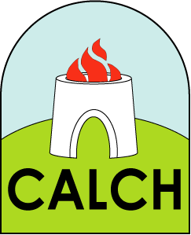
History
Unit 3

Slide 2
www.britishpathe.com/video/quarry-and-goat-issue-title-hot-and-cold

Slide 3
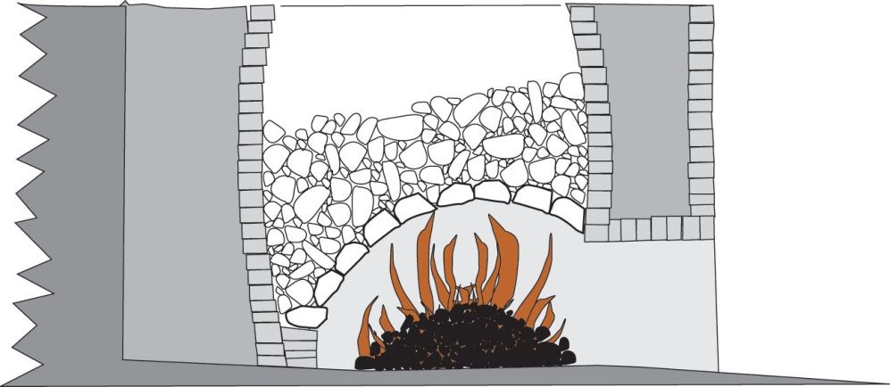
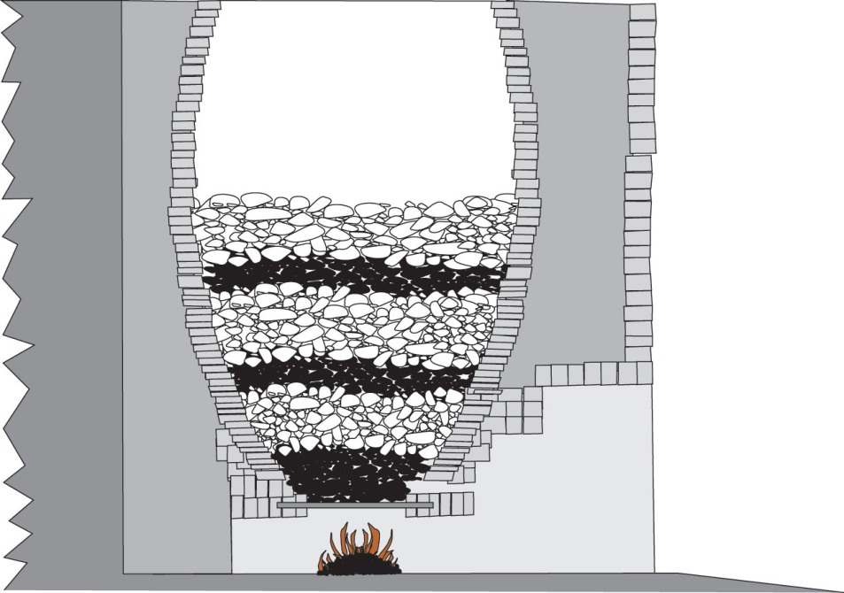
A flare kiln
In a flare kiln the fuel was lit at the bottom of the kiln and then the kiln was filled with limestone.
A draw kiln
A draw kiln worked by layering coal and limestone. Once lit the kiln could be kept going day and night by adding more layers.

Slide 4
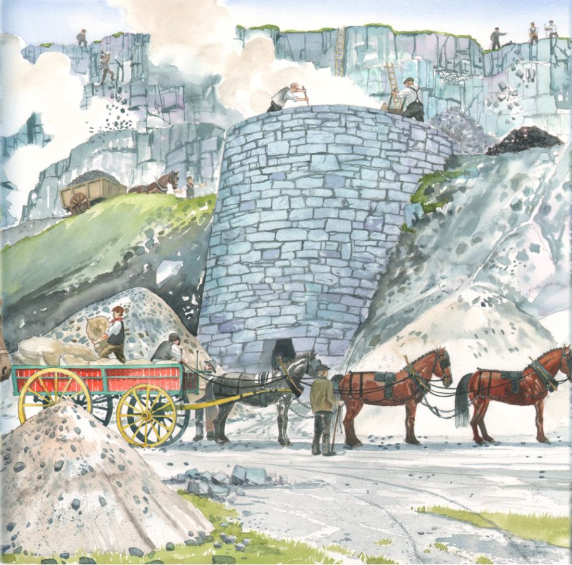
1. What’s the difference between a flare kiln and a draw kiln?
2. Why did a draw kiln produce more lime?

Slide 5
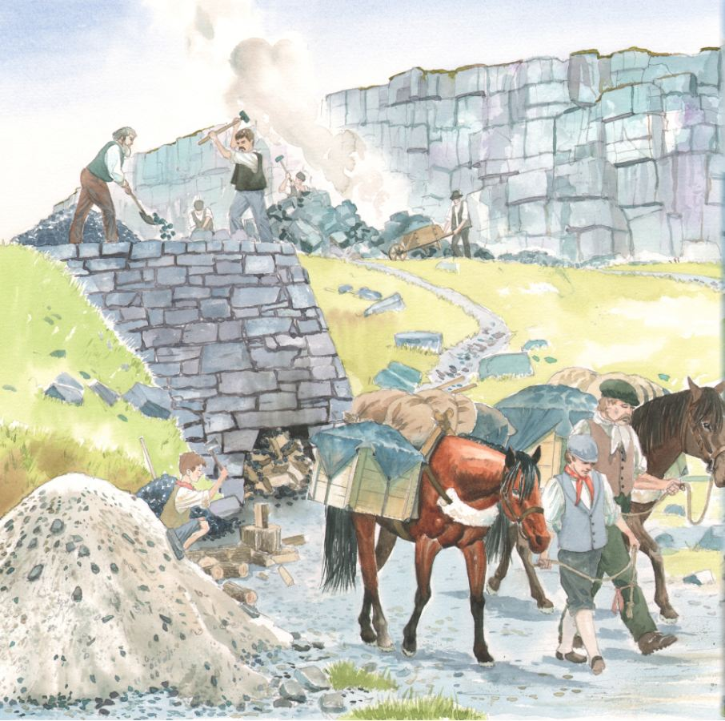
A quarryman's day

Slide 6
I get up at 5am to start work at 6am. I have my breakfast and get ready for work.
We start the day breaking rocks to fill the kiln.
Bedtime at 11pm
We finish work at 8pm as it is starting to get dark. I then spend the evening catching and preparing my food for the next day.
We have a short break at 10am
A quarryman's day
After a break at 4pm we move to kiln 2 to empty the kiln that has already burnt. We bag up the lime ready for it to be taken to the farms.
From 10.30am to 1pm we continue to break rocks and load them into carts to take to the top of the kiln.
1pm is lunch time!
After lunch we load the kiln with limestone and coal ready for it to be lit.

Slide 7
Compared to your day, do you think the daily life of a quarryman was hard? Explain your answer
2. Most quarrymen were farmers who worked at the quarries for lime for their land. Why was lime so important?

Slide 8
