Slide 1
Llyn y Fan Fach
Geography – Lesson 1

Slide 2
Aims
To discover how Llyn y Fan Fach lake was created.

Slide 3
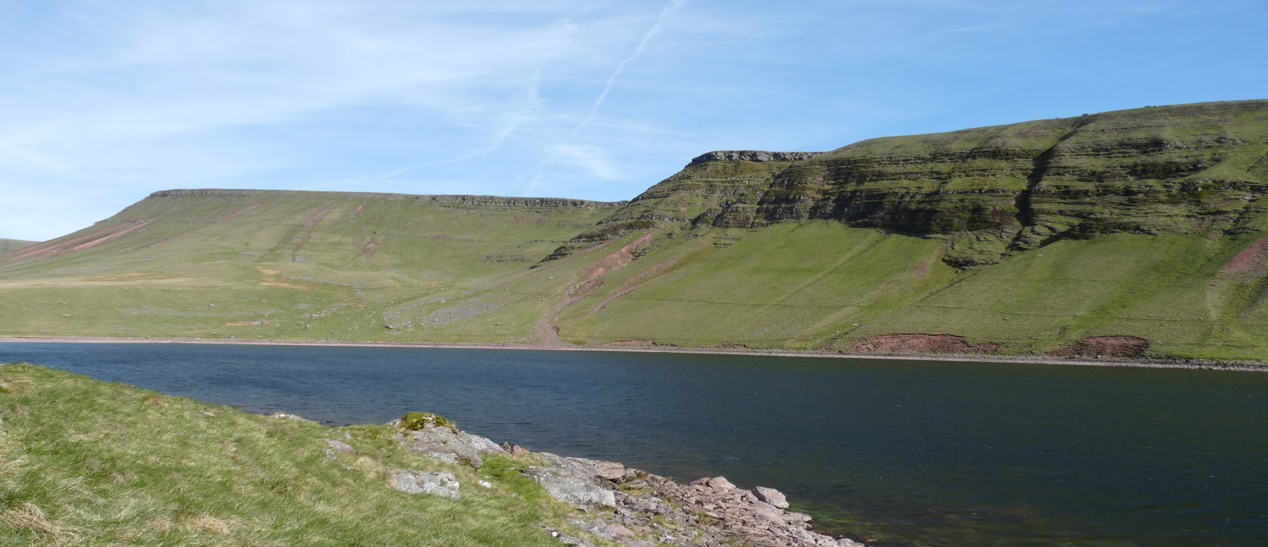
Llyn y Fan Fach

Slide 4
Llyn y Fan Fach (Lake of the small beacon-hill)
Llyn y Fan Fach is a 10 hectare lake on the western side of the Brecon Beacons. The lake itself is overlooked by the mountain peaks of Picws Du and Waun Lefrith. The northern face of Waun Lefrith was home to a glacier during the Ice Age which gouged out the corrie (or cwm) in which Llyn y Fan Fach now sits.

Slide 5
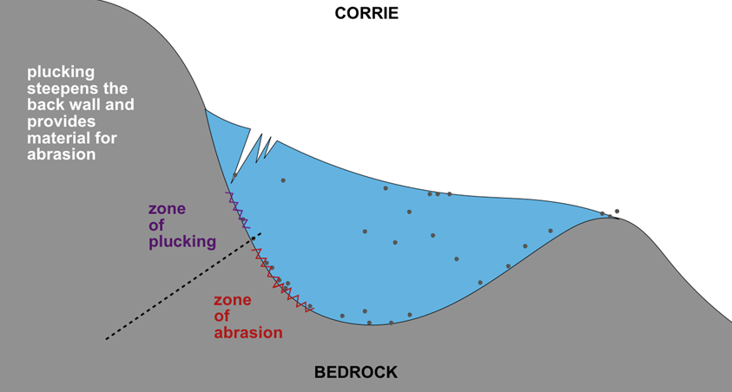
Llyn y Fan Fach is an example of a corrie lake. A corrie is formed when snow collects in a hollow on the side of a mountain. Over time as more snow falls, snow below is compacted to form ice. This ice then deepens and widens the corrie via the process of abrasion and plucking.

Slide 6
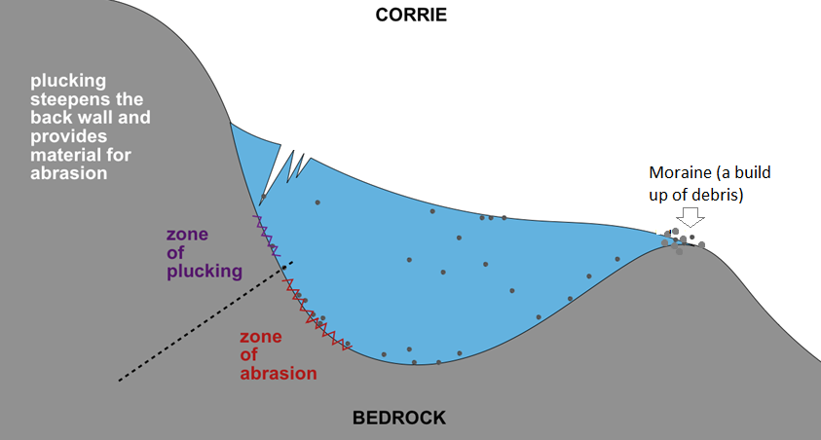
Gravity will compel the ice to try to move downhill, even though it is unable to as it is trapped in the hollow. As the ice rotates is carves out an armchair shaped hollow with a steep back wall. A moraine (a build-up of debris) is formed on the edge of the corrie stopping the ice as it builds up from being able to move downhill. When the ice in a corrie melts, a circular lake is often formed at the bottom of the hollow, this is known as a tarn.

Slide 7
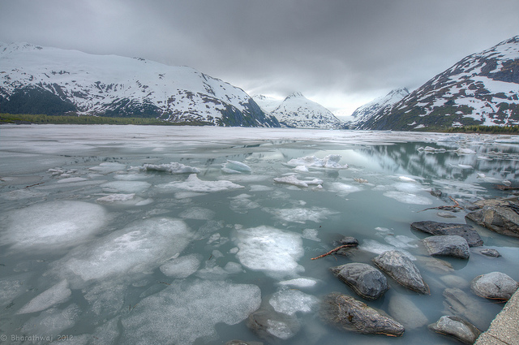
Llyn y Fan Fach was a corrie over 11,000 years ago during the last Ice Age.

Slide 8
Describe how a corrie lake is created.

Slide 9
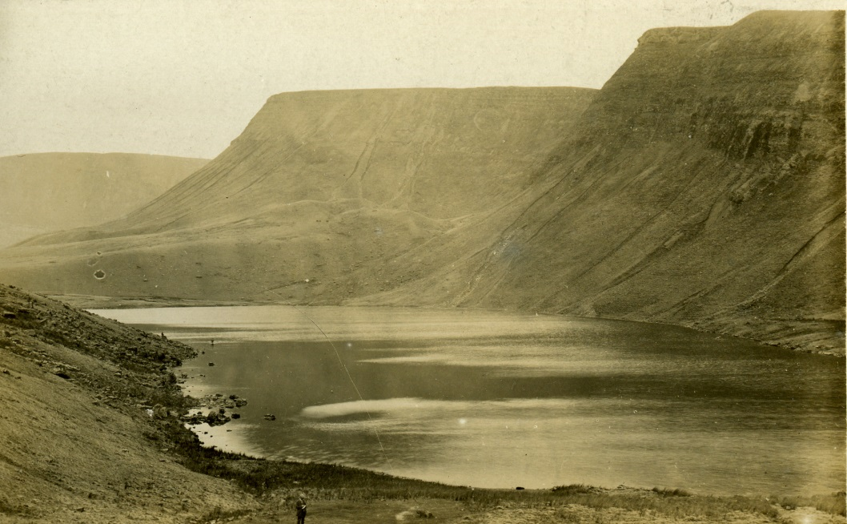
Draw and label a corrie. Use all of the keywords.

Slide 10
Match the keywords
A build-up of debris formed on the edge of the corrie causing a dam effect.
Corrie
Plucking
A lake created after the ice in a corrie melts.
Abrasion
A hollow carved out by glacial ice.
Tarn
Occurs when rocks scrape the base of the corrie.
Moraine
When ice forms around rock fragments.

Slide 11
Look on the internet to find other examples of corries and tarns.

