Slide 1
Pembrey at war – Lesson 2

Slide 2
Aims
What was the significance of women at Pembrey munitions factory?

Slide 3
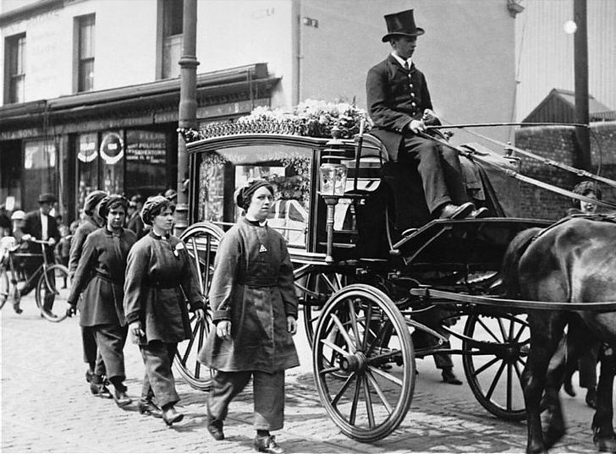

Slide 4
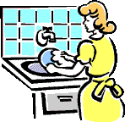
A woman’s role is in the home?
Before the outbreak of the first World War it was believed that a woman’s place was in the home.
Discuss;
How do you think this changed when war broke out?

Slide 5
A woman’s role is in the home?
Women played a major role in World War I. When the men went off to war the women stepped up to take on the jobs left empty.
This led to them being given the vote at the age of 30 in 1918 and at the age of 21 by 1928.

Slide 6
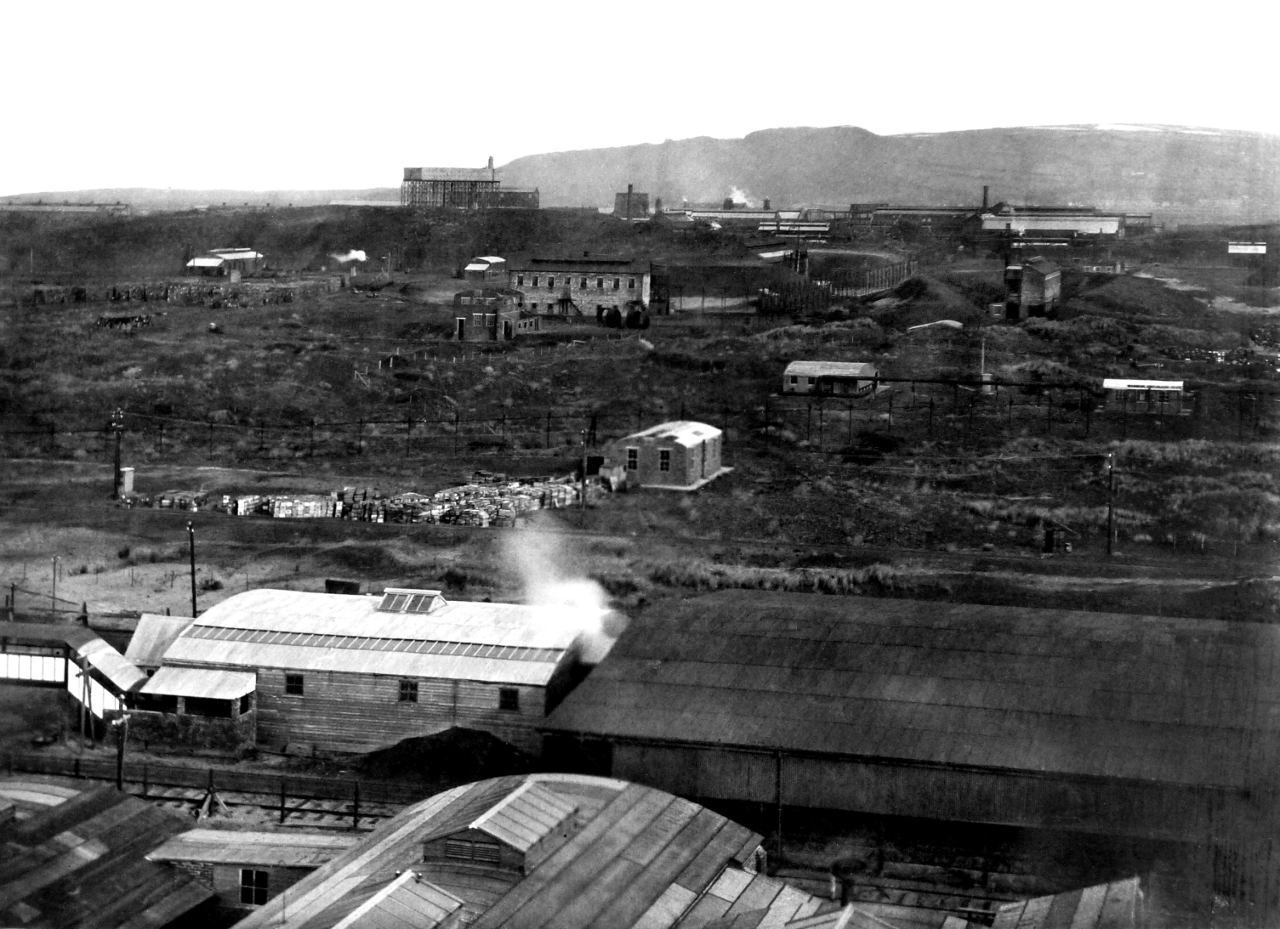
At Pembrey in South Wales there was a huge 700 acre factory site. Today it is the Country Park. Stowmarket Explosives first started making explosives amongst the sand dunes in the 1880’s but this closed after an explosion killed 7 people. Nobel’s Explosives Manufacturing Ltd built a factory on this site which went on to be nationalised during the First World War. There were over 400 buildings on the site.

Slide 7
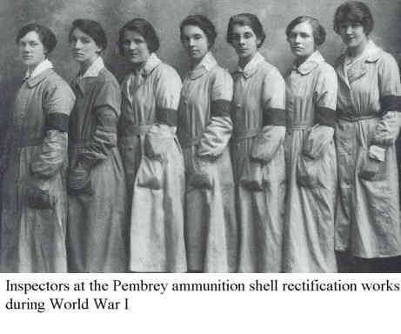
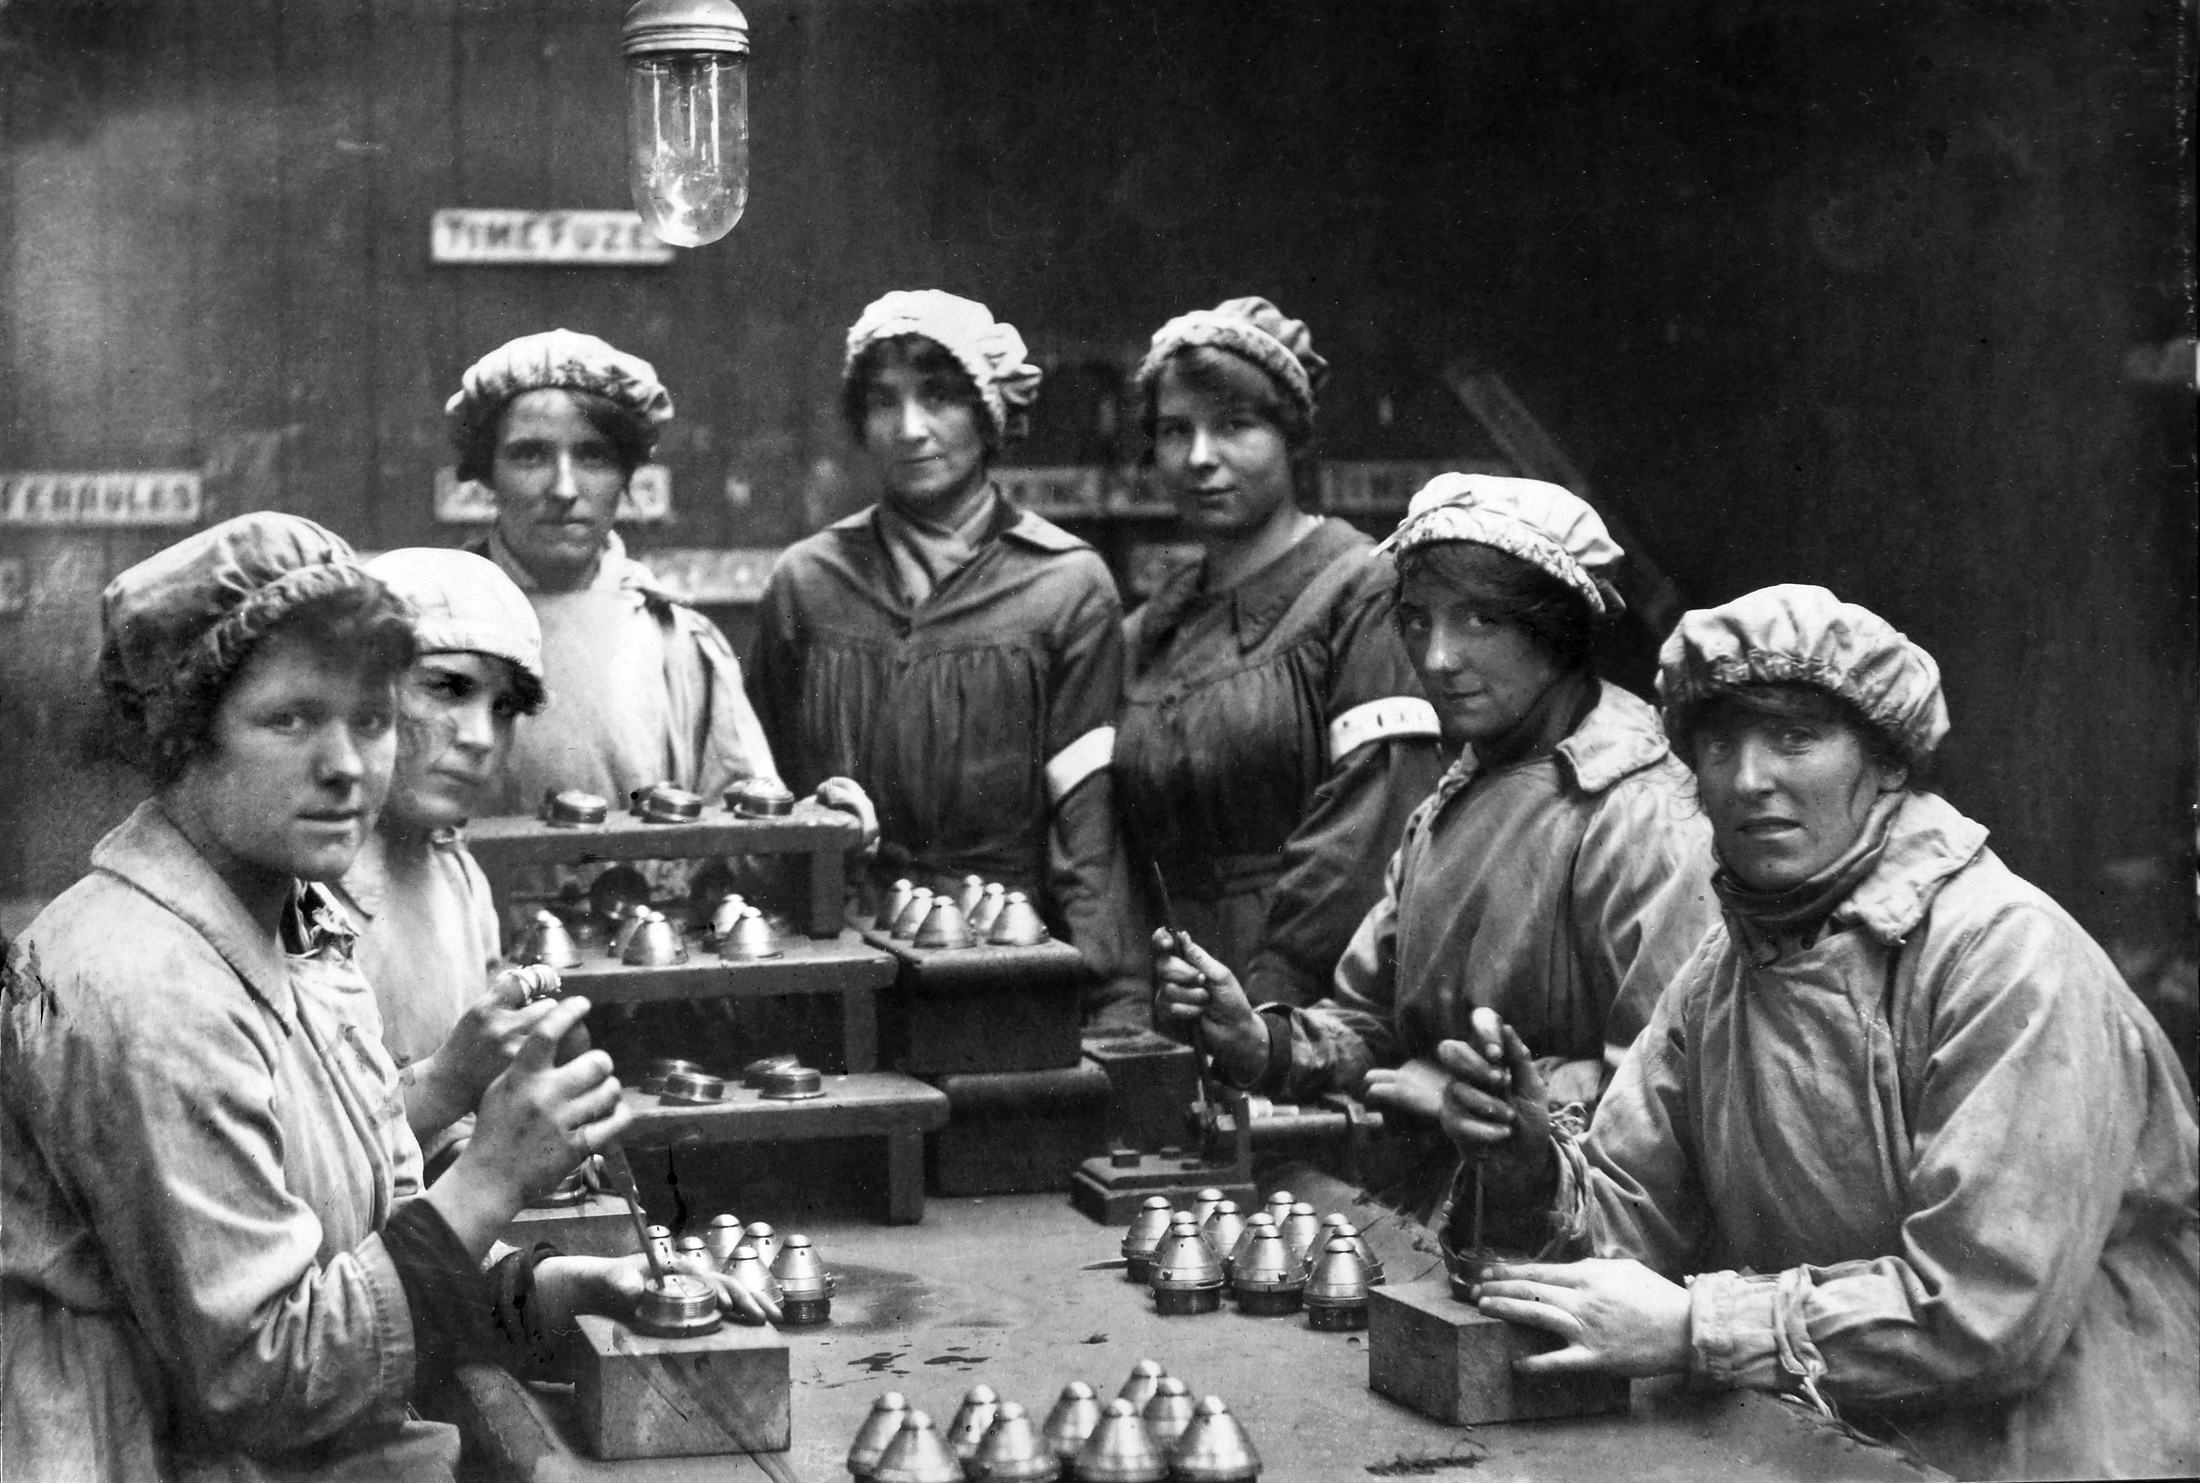
The Pembrey site was home to a series of large munitions factories and weapons stores. In World War 1 this was the site of one of the largest such plants in Wales, producing dynamite, TNT and propellant.
From 1916 over 3000 women were employed on the shop floor, undertaking dangerous tasks such as filling shells.
Why did so many women work at Pembrey?

Slide 8
Imagine you are a female applying for a job at Pembrey munitions factory at the start of the first World War.
How would you convince the factory managers that you are the best person for a job traditionally completed by a man?
You could use the phrases
I believe I would make a good factory worker because …..
The skills that would help me in this role are ….

Slide 9
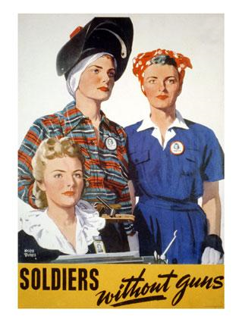
When men returned from the frontlines after WW1 women were no longer needed in the workplace and they returned to domestic duties.
However war broke out again in 1939
What problem did British employers face when WWII broke out?
What does this poster tell us about a woman's role?

Slide 10
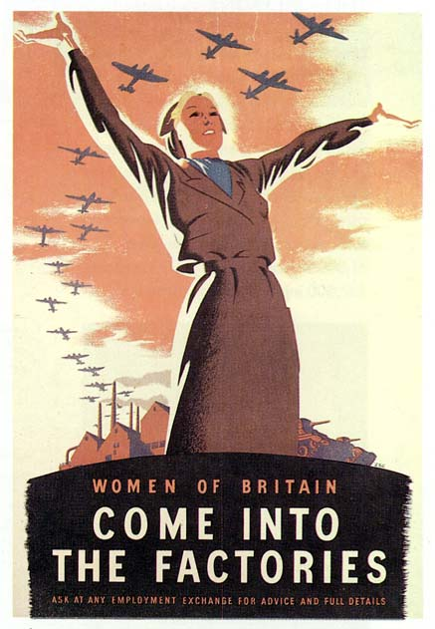
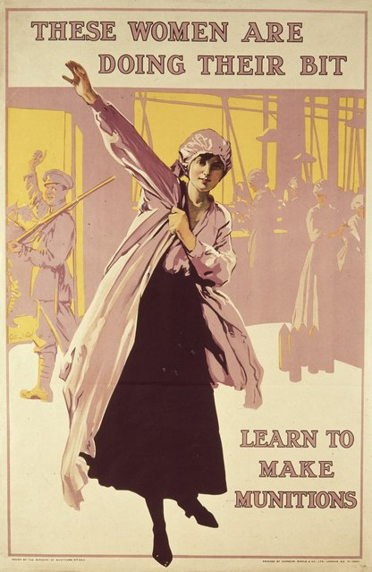
“The girls here are very rough, so are the conditions”
“The ether in the cordite affects some of the girls. It gives them headaches, hysteria and sometimes makes them unconscious.”
“The TNT stinks, no other word describes it, an evil sickly chokey smell that makes you cough until you feel sick”
“The factory is very badly equipped as regard the welfare of the girls. Although the fumes mean 16-18 casualties a night there are only 4 beds in surgery” Gabrielle West
3) Why would the women still want to work in a place like this?

Slide 11
Pembrey, Llanelli: Funeral of Munition Factory Workers
In July 1917 an enormous explosion rocked the entire site and six workers – 4 men and 2 women – were instantly killed. The subsequent inquest decided that the cause of the explosion was unknown.
Although four men lost their lives, it was the funeral of the two female victims – 18 year old Mildred Owen, and 19 year old Mary Watson – that drew the largest crowd. Their coffins draped in the Union Jack, the girls were mourned by their fellow munitions workers, some of whom wore their working uniform.
One fellow worker even composed a poem commemorating the two women, concluding
‘…Their memory shall live for aye And Wales shall honour it, and sing The praise of those who gave their lives For England’s fighters and their king’

Slide 12
Why was the death of these two women significant?

Slide 13
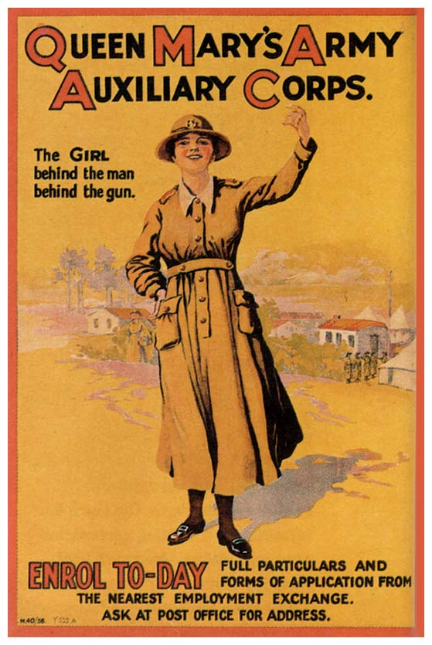
Conscription
At first single women aged 20-30 were called up to work. By mid 1943 90% of single women and 80% of married women had been called up.
“It was emphasized that women would not be required to bear arms”
Why do you think this was?

Slide 14
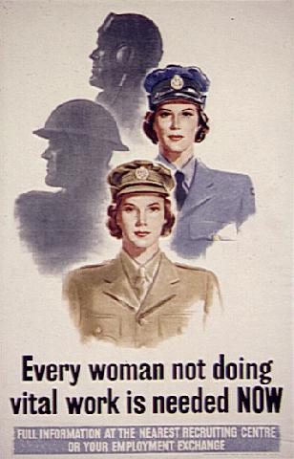
At the end of the second World War women’s contribution to the war effort was celebrated. They had made a huge difference to the war effort.
Ironically Hitler didn’t use German women to help with the war – he believed their place was in the home.

Slide 15
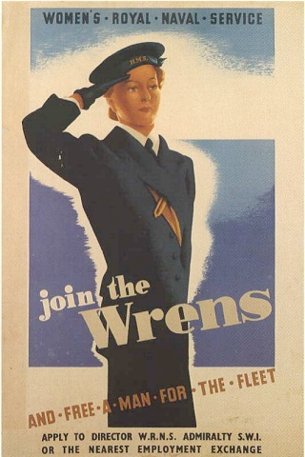
8) What do you think happened next for these British working women?
9) Do you think the World Wars had an effect on equality for women?

