Slide 1
Art & Design
Unit 3/4

Slide 2
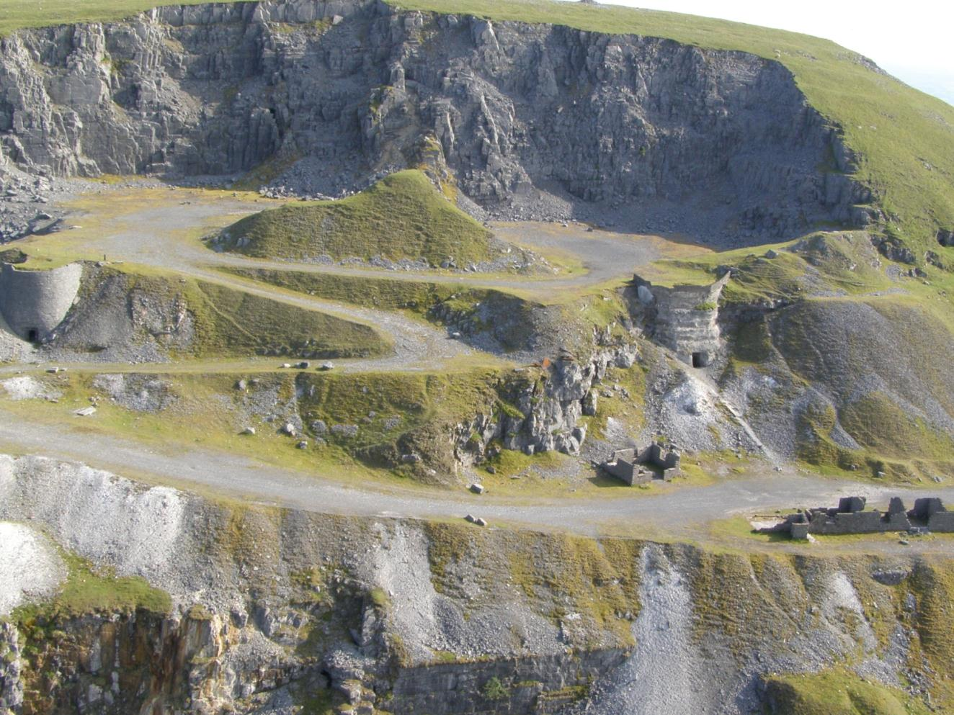

Slide 3
Pattern
Colour
Texture
Think about what you saw and how you felt at the quarries. How we can use observations and feelings and turn them into something creative?
Shape
Tone

Slide 4
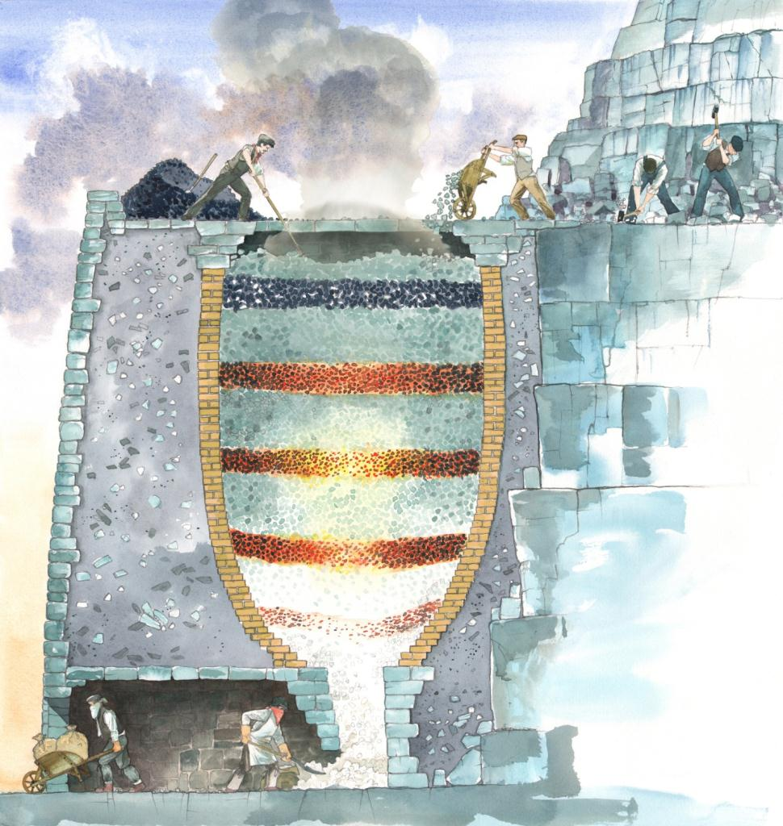
Think about;
What it must have been like to work in the quarry?
Why they needed the lime so badly
Was it worth it?

Slide 5
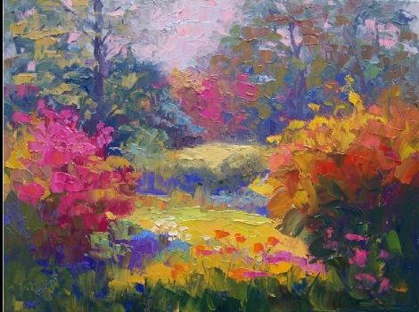
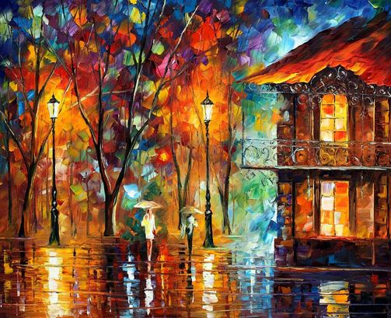
Can the work of other artists help you develop your work?

Slide 6
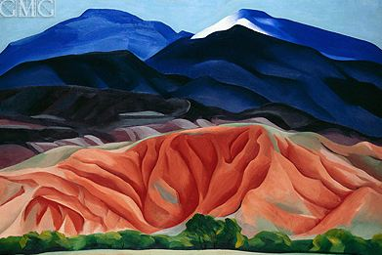
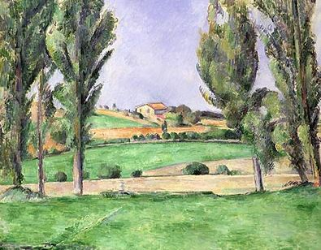
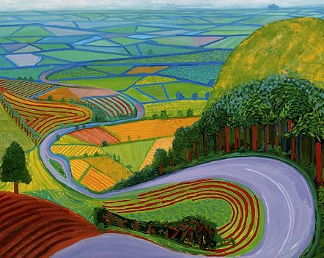

Slide 7
