Slide 1
Geography
Unit 4

Slide 2
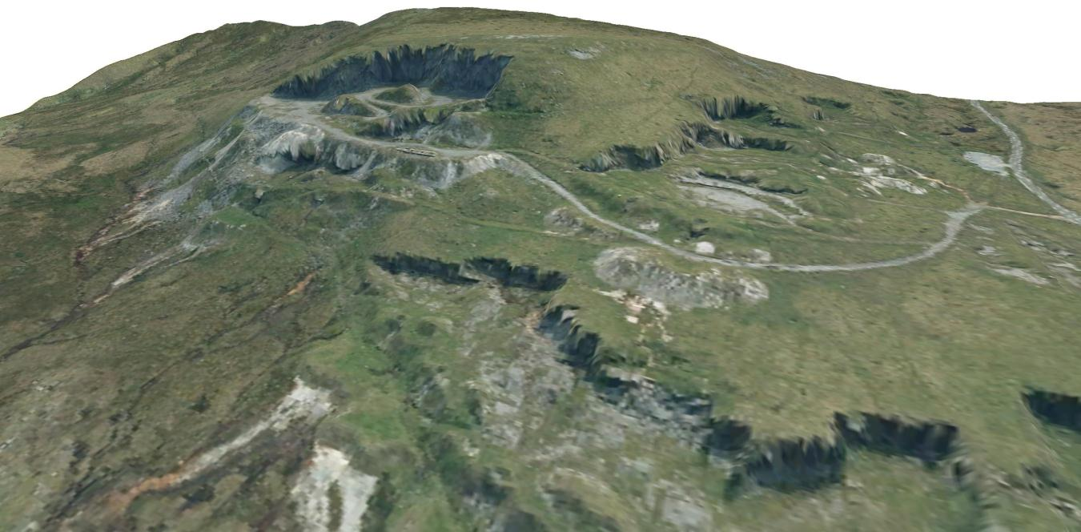
Time to produce a poster on the information gathered.

Slide 3
What to include in your poster
Geological maps of the area.
Information on limestone found there.
Photographs/drawings with descriptions.
Links to sites that can provide more information (ie SSSI)
You may use the internet to find images or you can draw them. The poster can perhaps be a protest about a quarry which is planned for the local area or an advertisement for worker for the quarry.
Try to use a range of arguments to support the claims in your poster.

Slide 4
