Slide 1







History
Unit 2

Slide 2
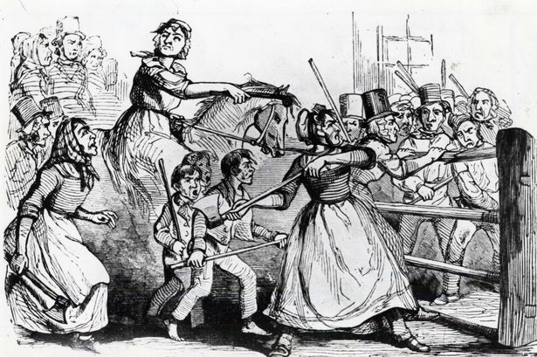

Slide 3
What were the Rebecca riots?

Slide 4
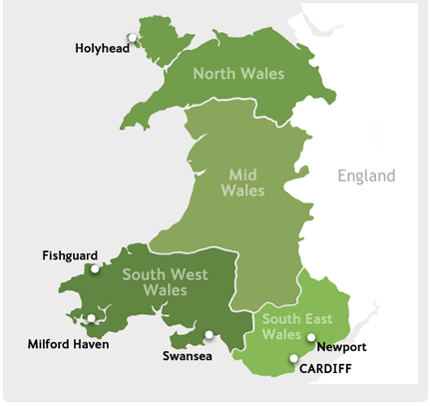
The Rebecca Riots took place between 1839 and 1843 in South and Mid Wales.

Slide 5
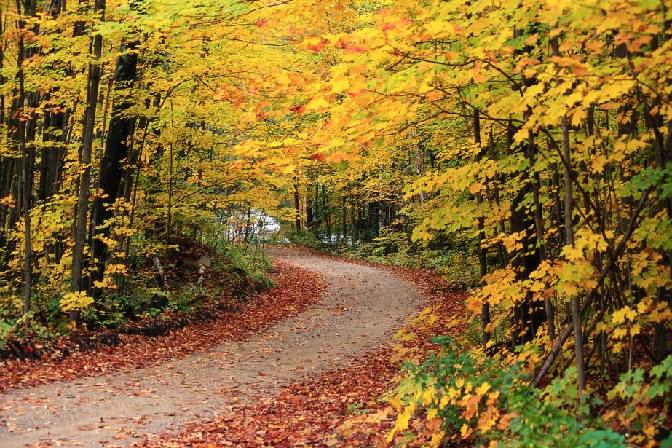
They were a series of protests undertaken by local farmers and agricultural workers in response to what they felt was unfair taxation. Tolls were placed on roads which had to be paid when passing through.

Slide 6

Welsh farmers attacked toll booths, burning and destroying them. They dressed as women to disguise themselves and were know as Rebecca’s daughters.

Slide 7
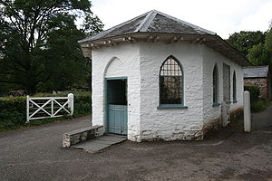
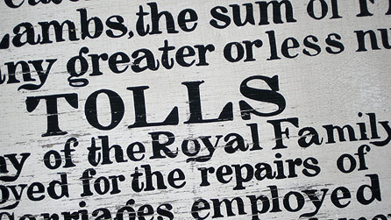
Toll booths were rebuilt and replaced by the turnpike trusts. Tolls were increased.

Slide 8
Rioters who were caught faced transportation to Australia or worse the death penalty.

Slide 9
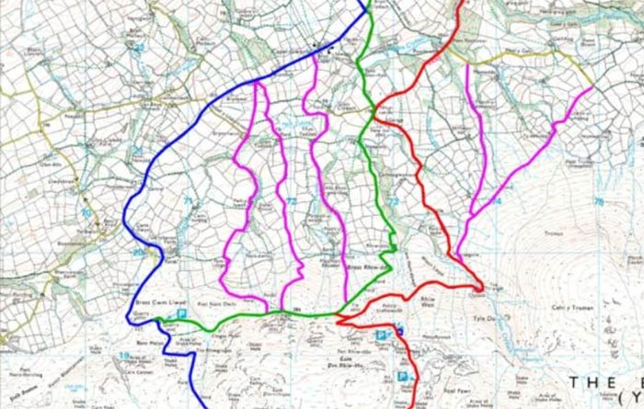
Why are there so many different roads over the Black mountain?

Slide 10
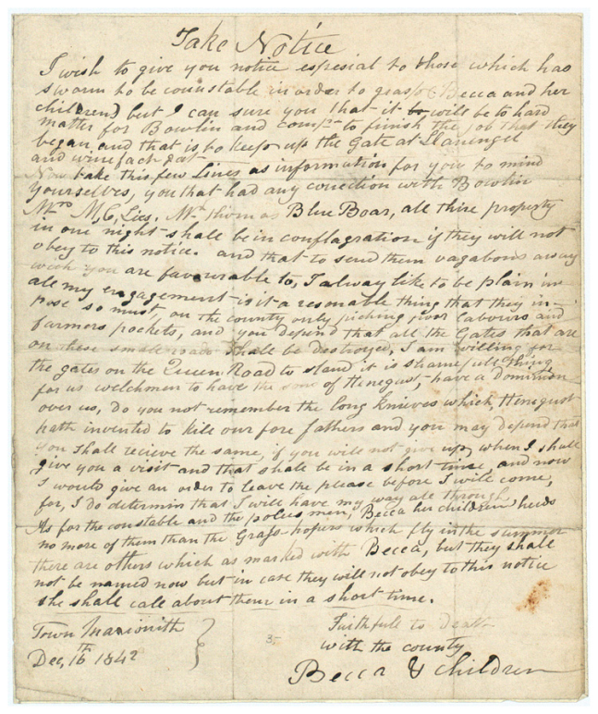
Either;
Write a letter to police from Rebecca’s daughter detailing your reasons for rioting and why you will continue
or
Address Rebecca’s daughters in a public statement detailing their crimes and how they will be brought to justice.

Slide 11
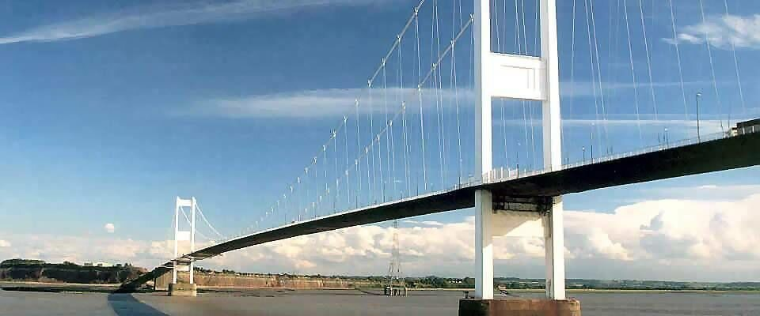
What are the pros and cons of toll roads?

Slide 12


