Slide 1
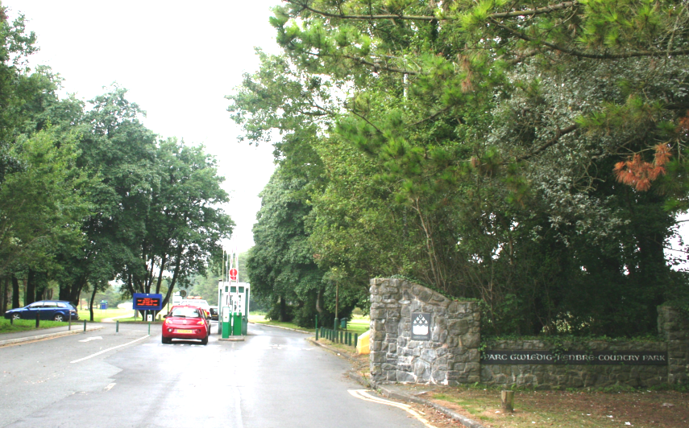

Slide 2
Aims
Investigate Pembrey Country Park’s explosive past.

Slide 3
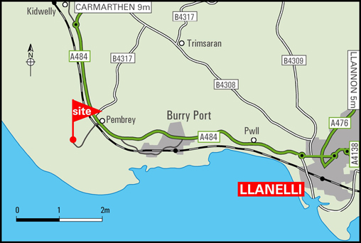
What do you know about Pembrey Country park?

Slide 4
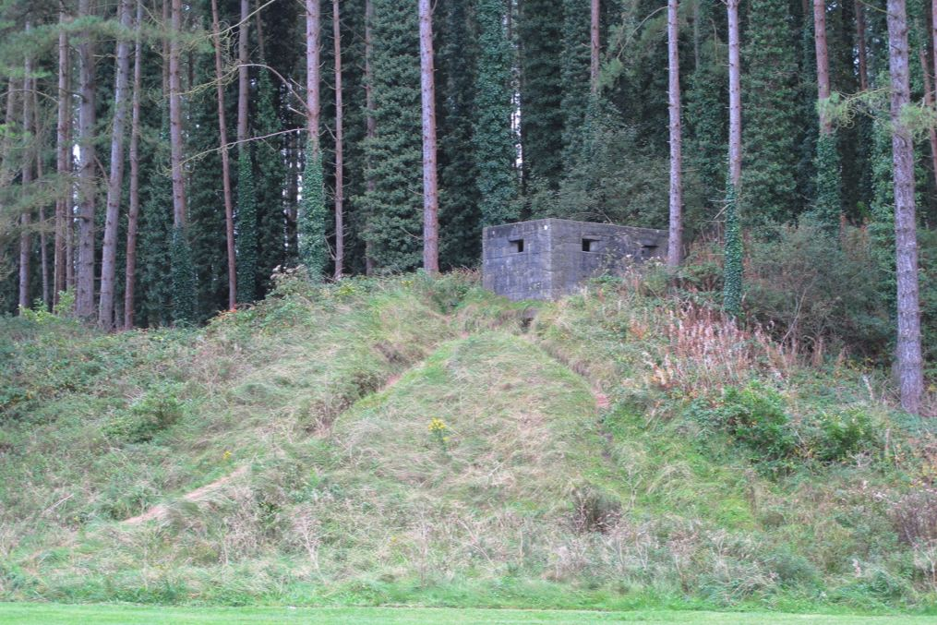

Slide 5
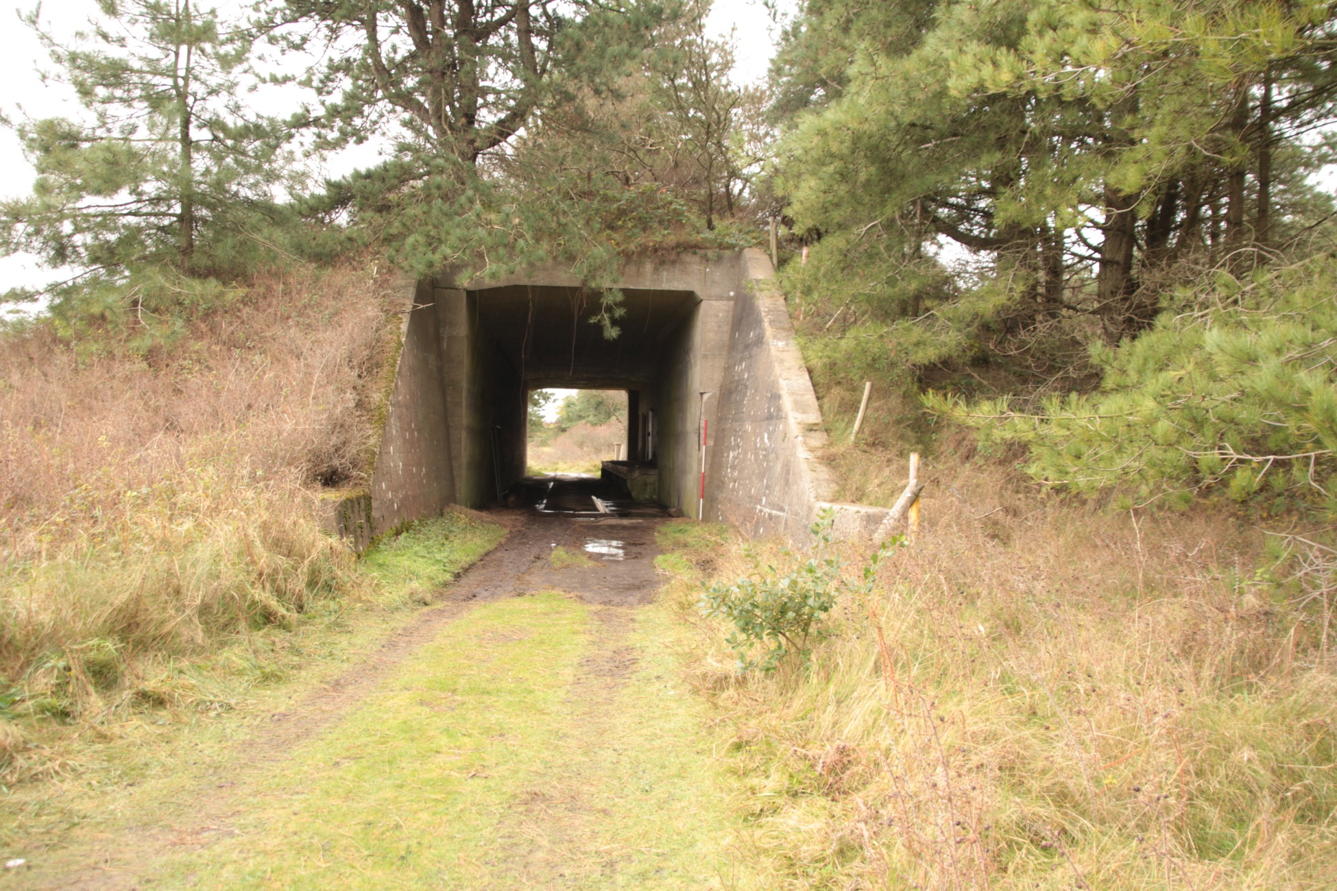

Slide 6
Time to split into groups, look at some sources and investigate further!

Slide 7
Each group choose 2 pupils to visit another group.
Both pupils each visit a different group to gather as much information as possible (Without looking at the groups sources and A3 sheet)
Remaining group members must give information to visiting group members (Without looking at your groups sources and A3 sheet)

Slide 8
Questions to think about when planning your presentation.
What was going on at Pembrey Country Park and why?
Who was Gabrielle West?
Who was working at Pembrey?
What were the conditions like? Would you work there?

Slide 9
Time to share what you have learnt!

