Slide 1
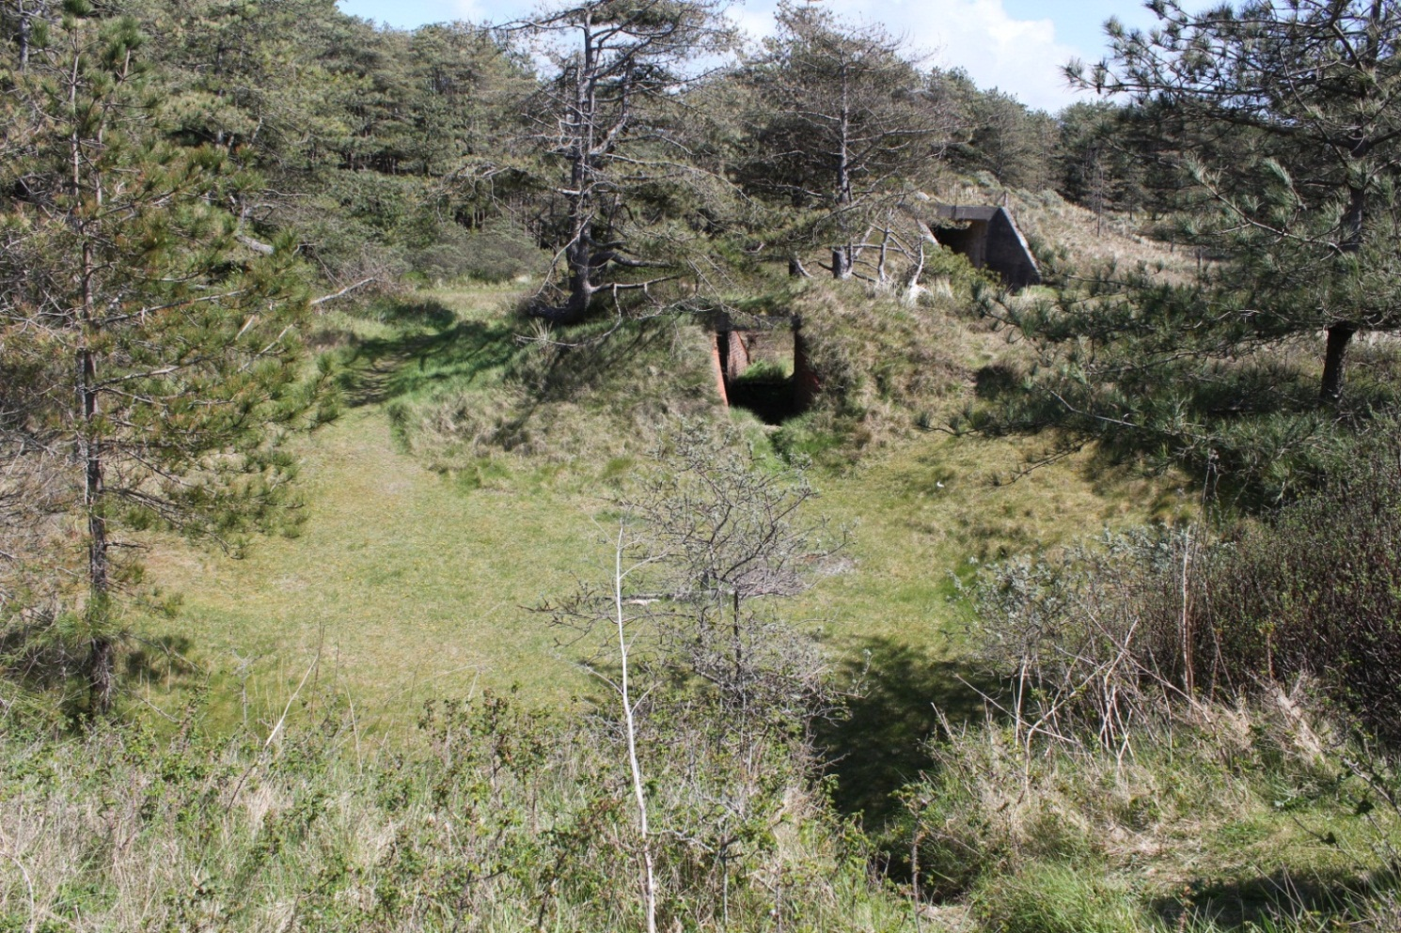
Pembrey at war – Lesson 3

Slide 2
Aims
Examine and explain the remains at Pembrey Country Park

Slide 3
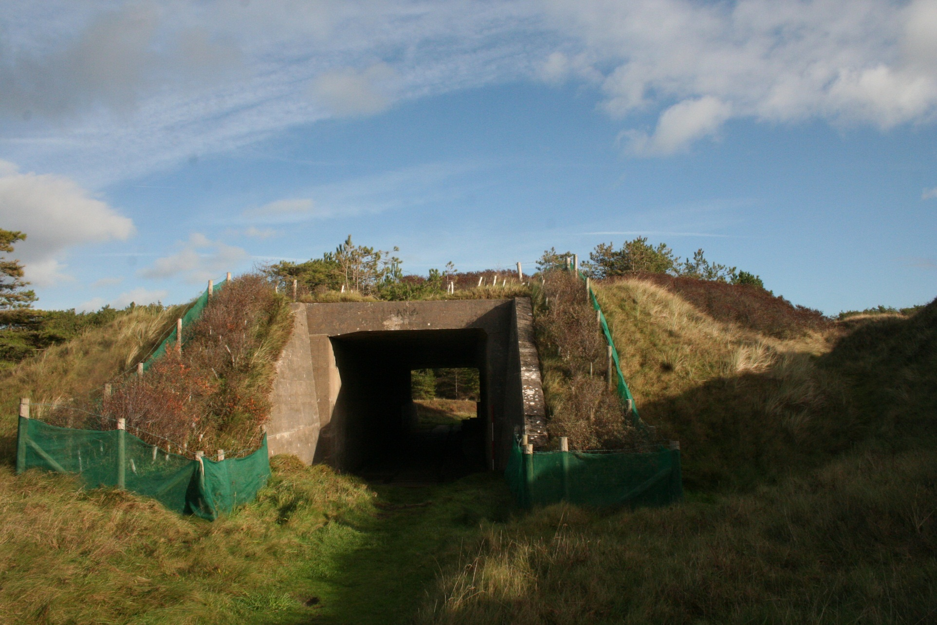

Slide 4
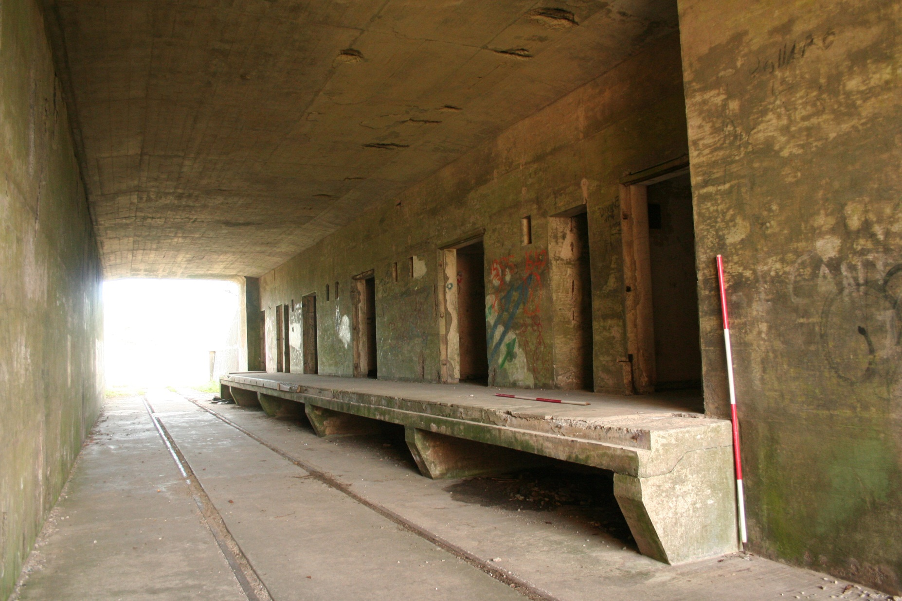

Slide 5
What is it?
What was it used for?

Slide 6
Does this photo taken during the 1940’s give us any more clues?

Slide 7
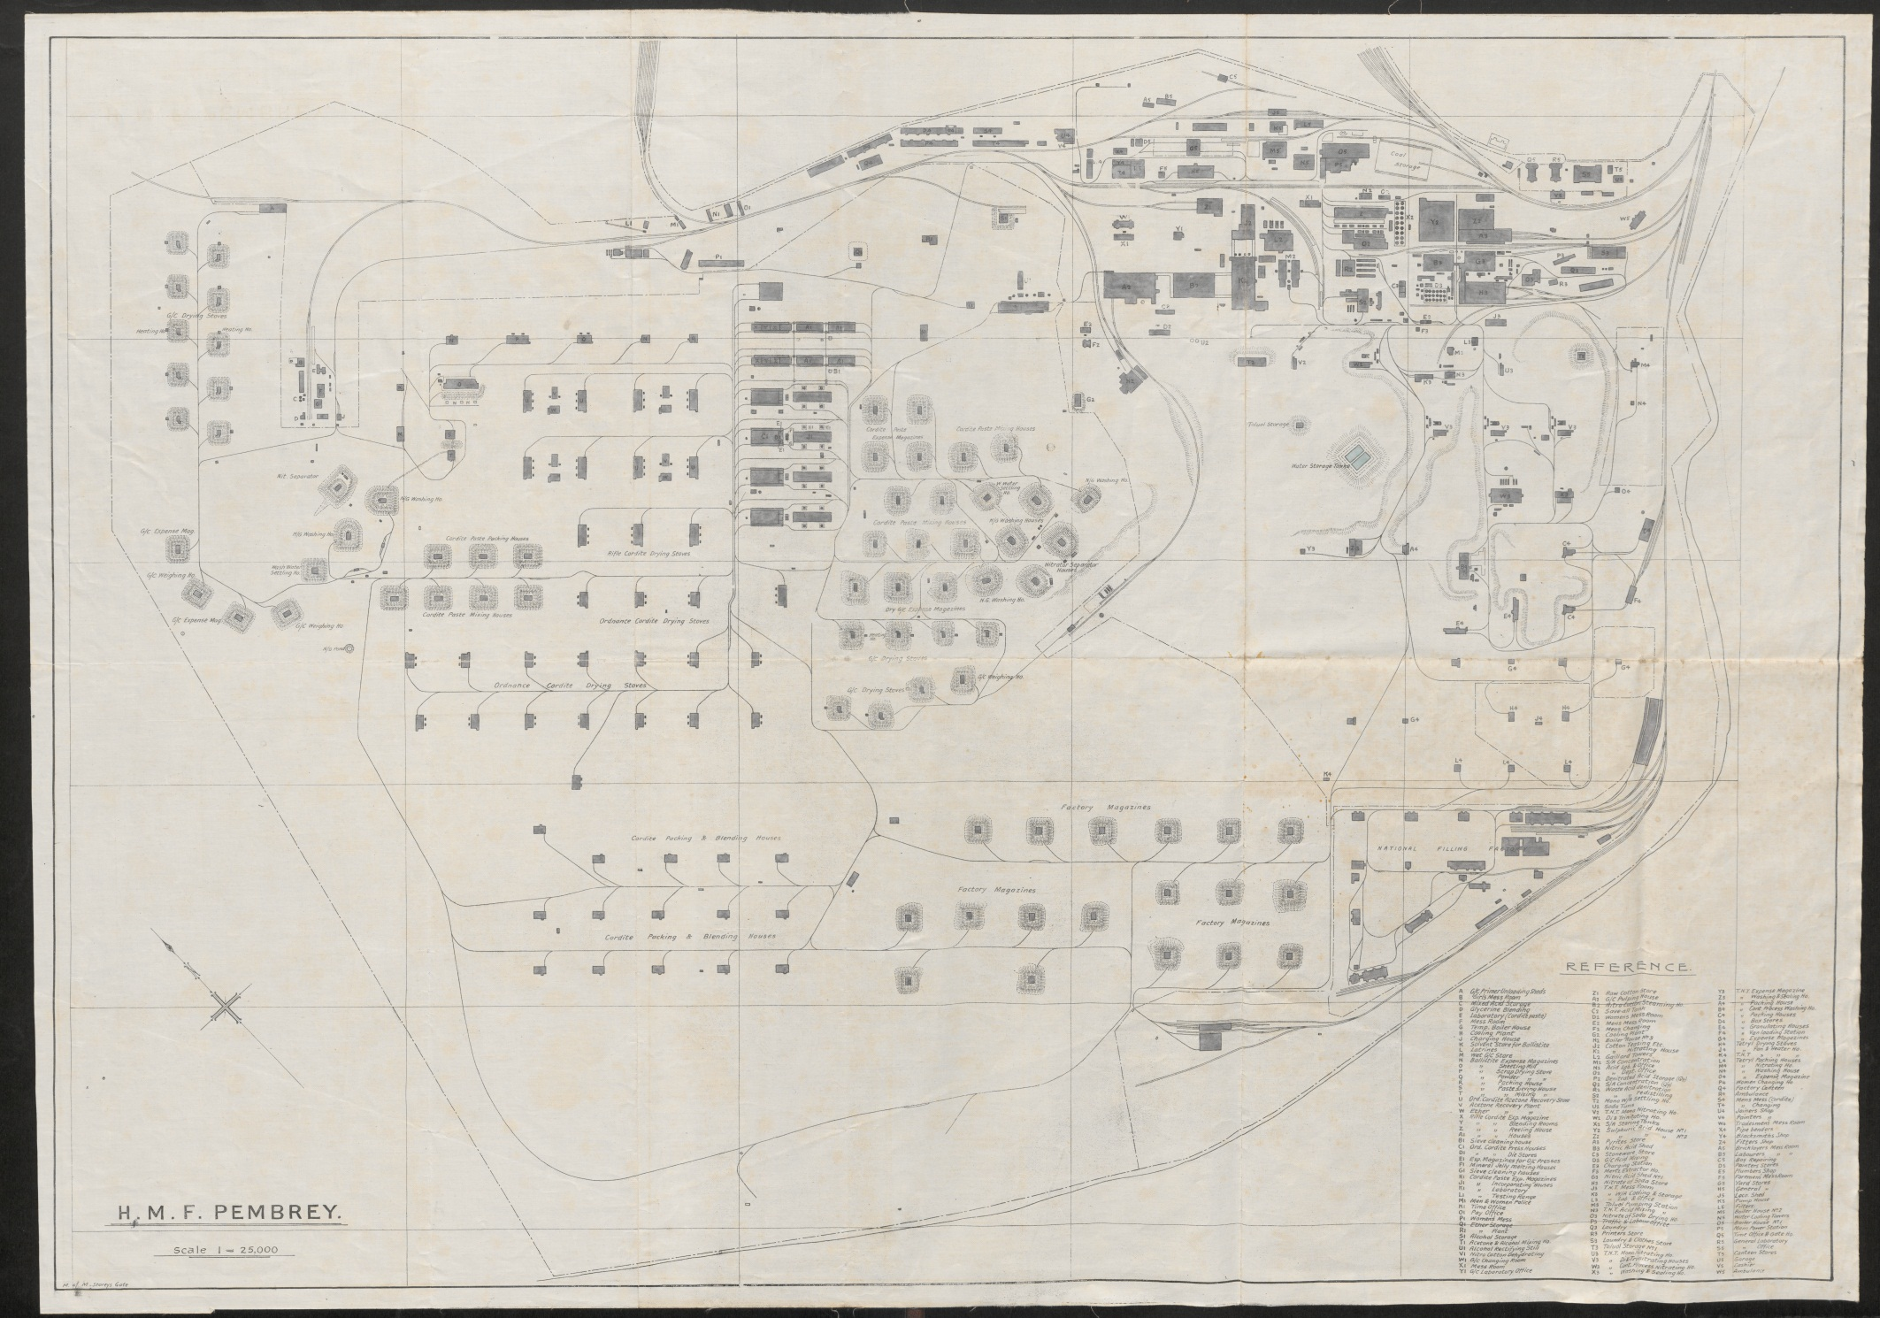

Slide 8
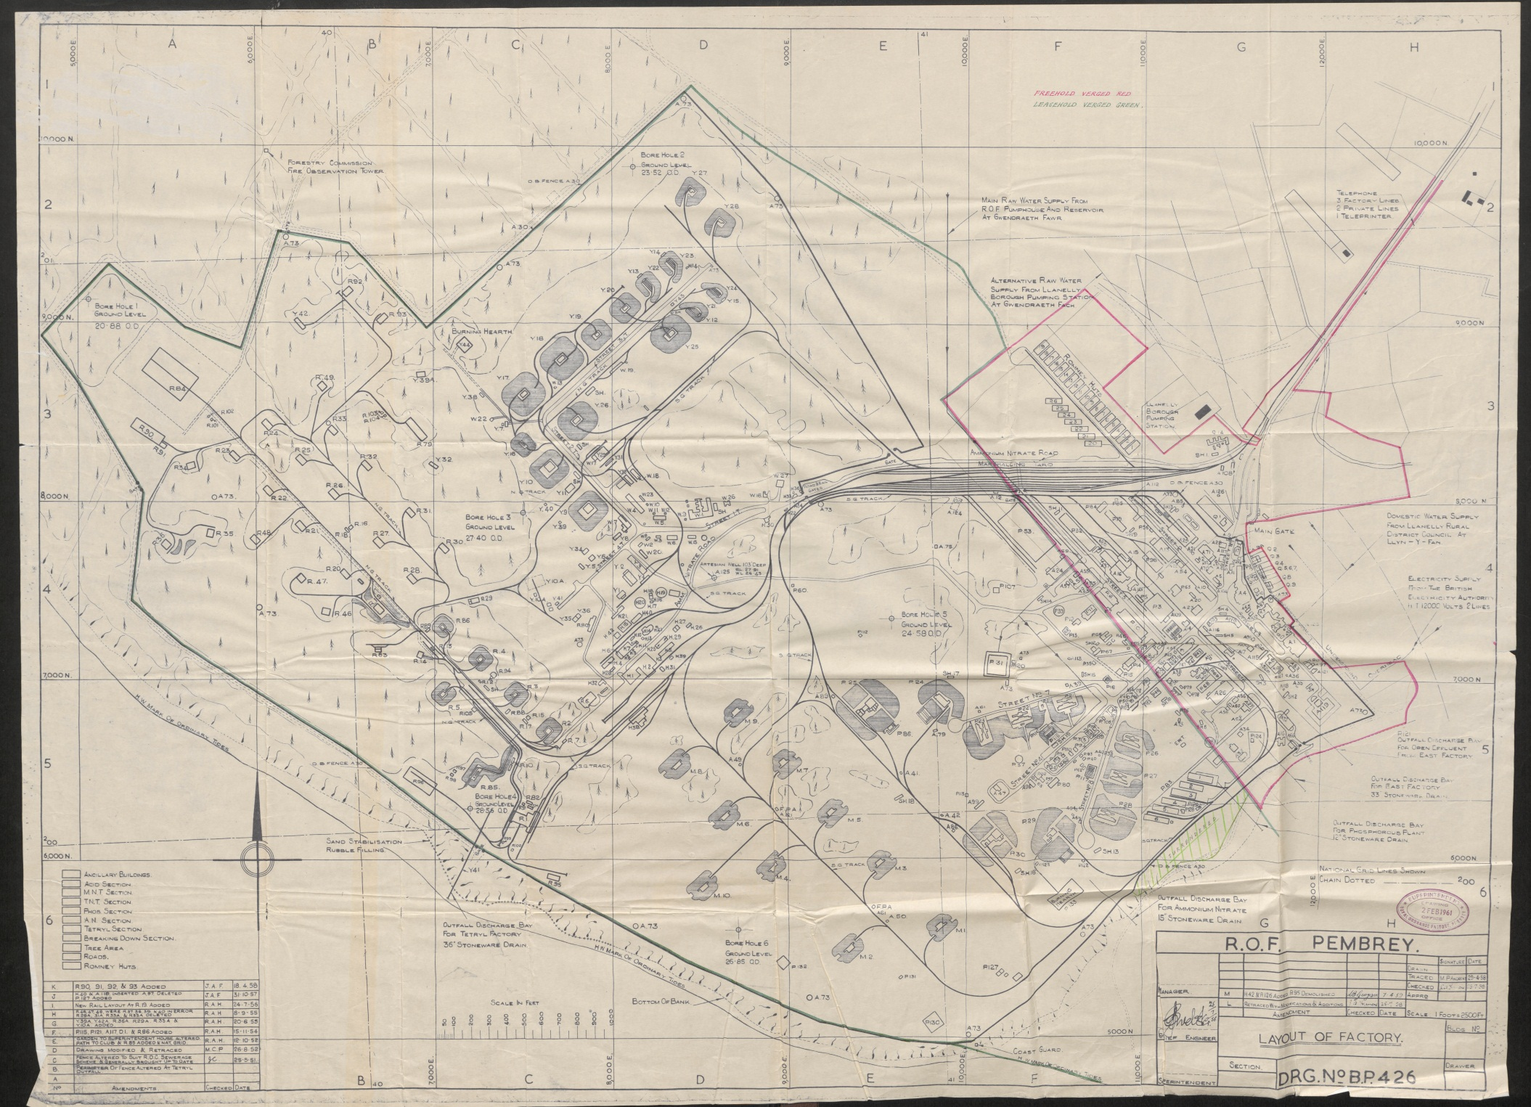

Slide 9
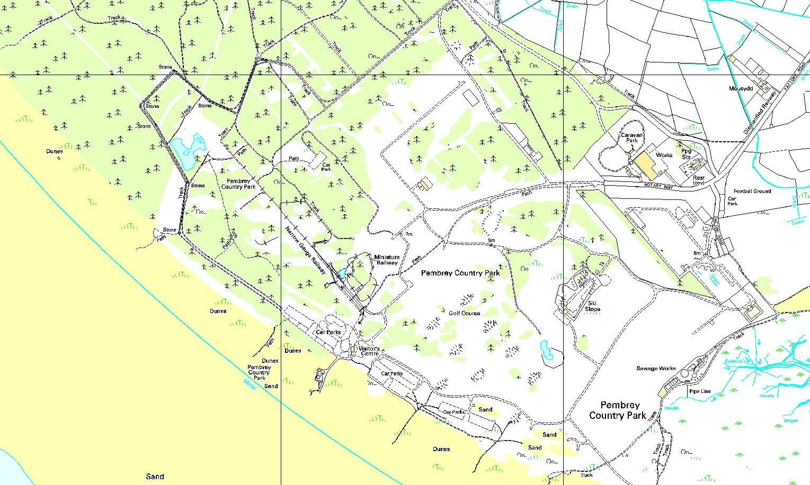

Slide 10
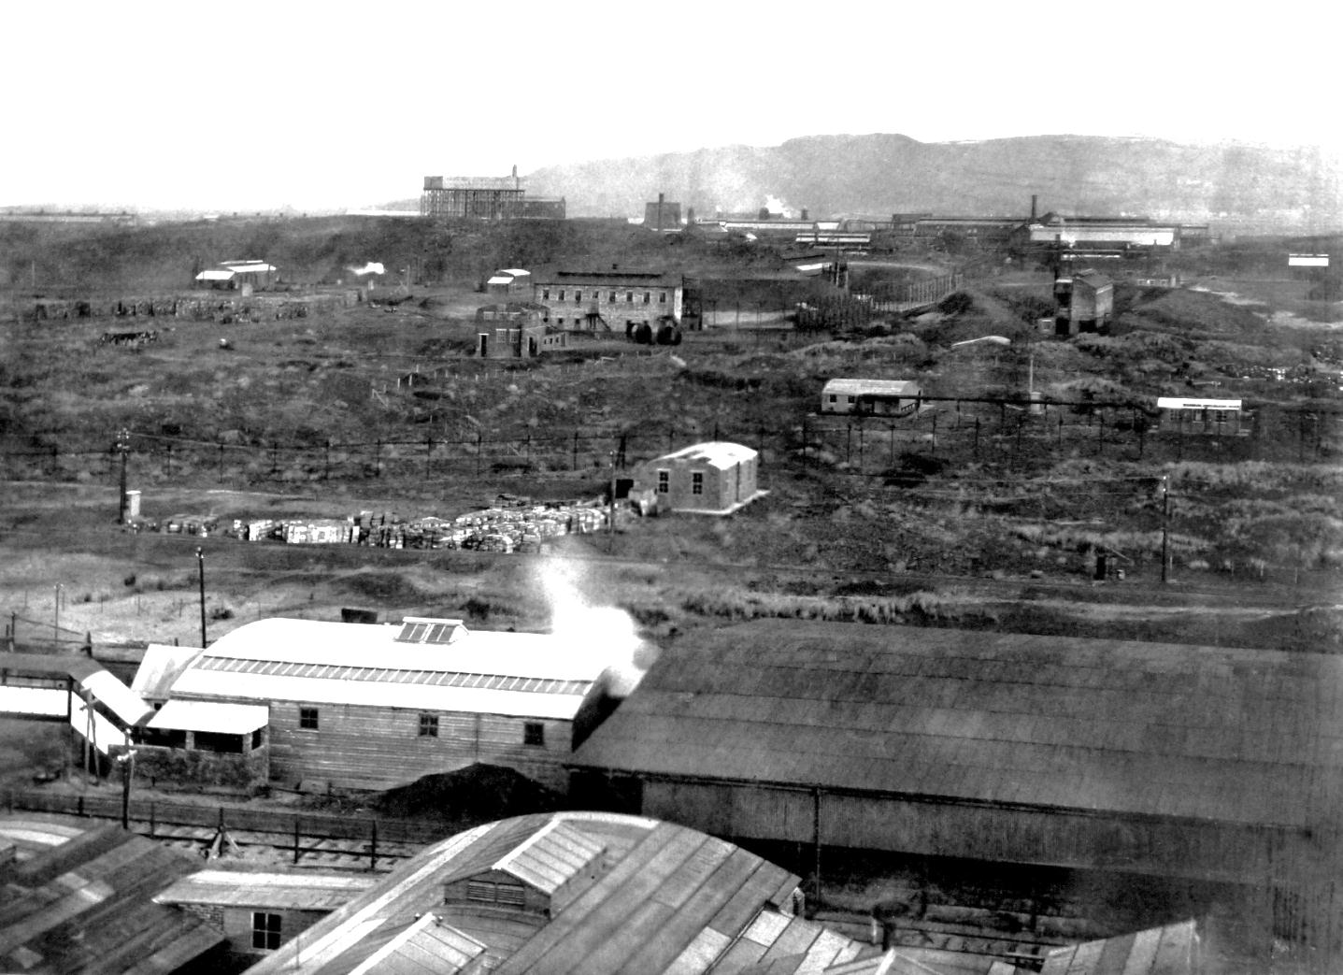
The munitions factory at Pembrey was over 700 acre’s in size during the first World War. Today it is the Country Park. Stowmarket Explosives first started making explosives amongst the sand dunes in the 1880’s but this closed after an explosion killed 7 people. Nobel’s Explosives Manufacturing Ltd built a factory on this site which went on to be nationalised during the First World War. There were over 400 buildings on the site. In World War 1 this was the site of one of the largest such plants in Wales, producing dynamite, TNT and propellant

Slide 11
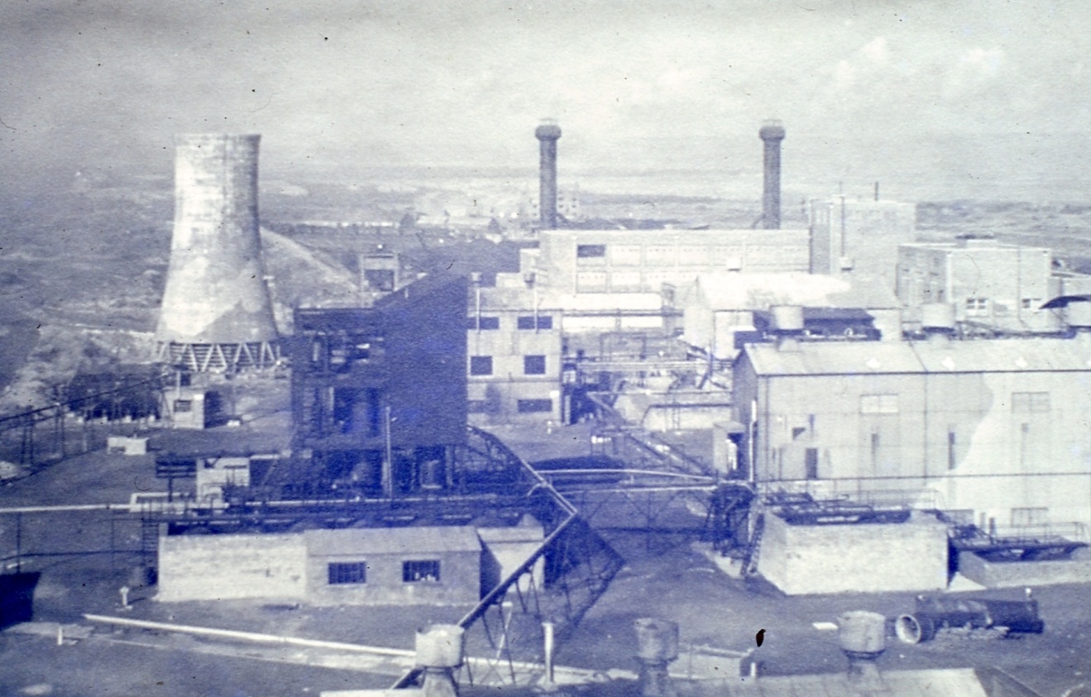
1. What have you learnt about Pembrey Munitions factory by examining the maps?

Slide 12
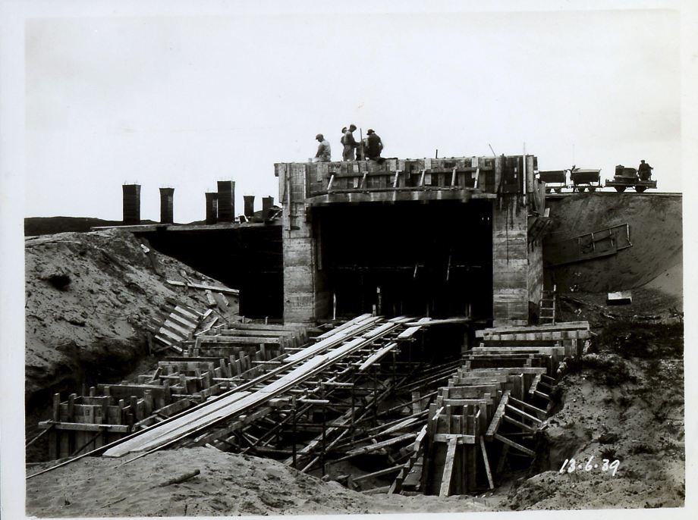

Slide 13
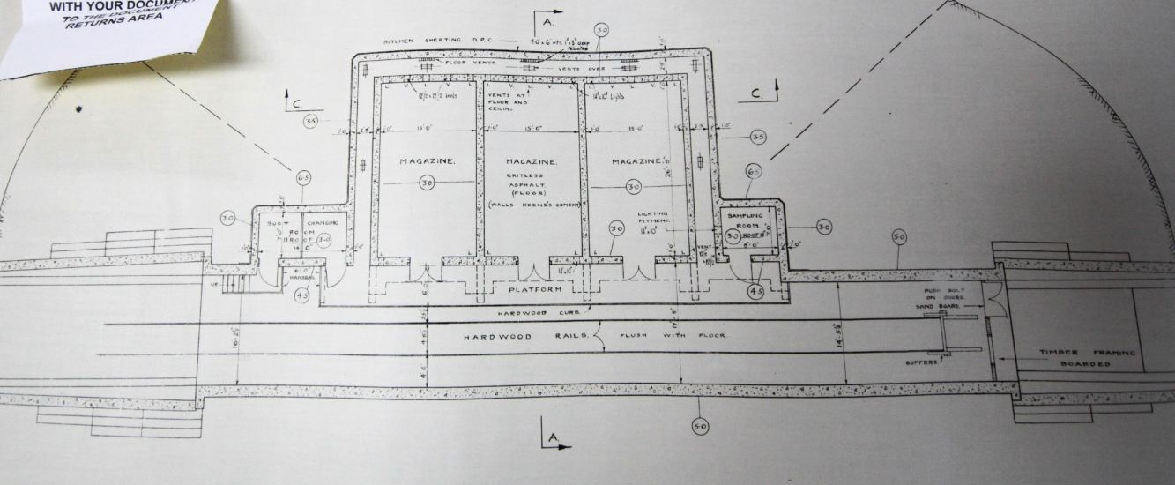

Slide 14
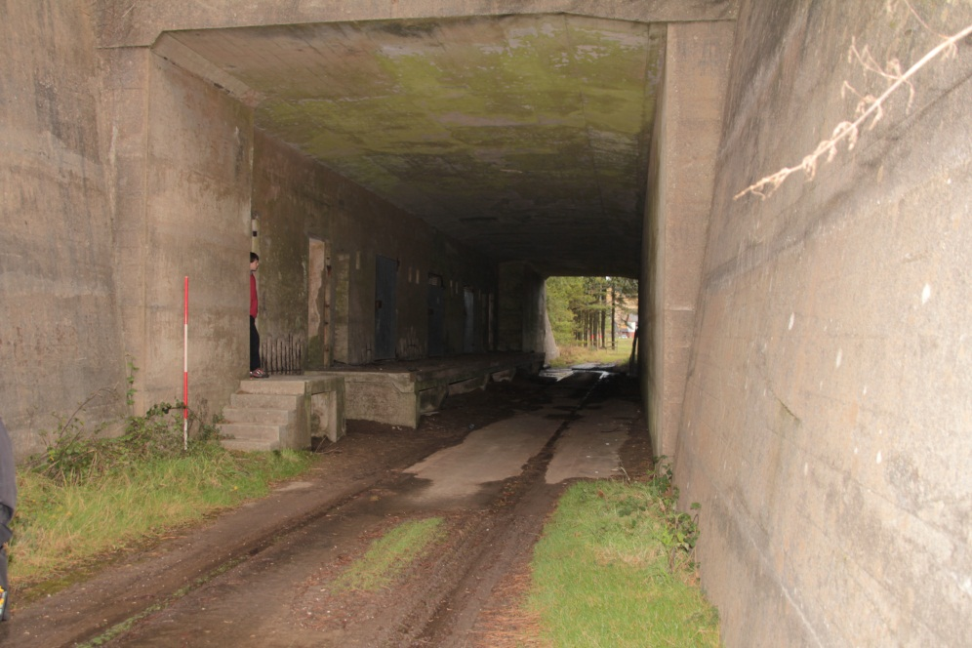
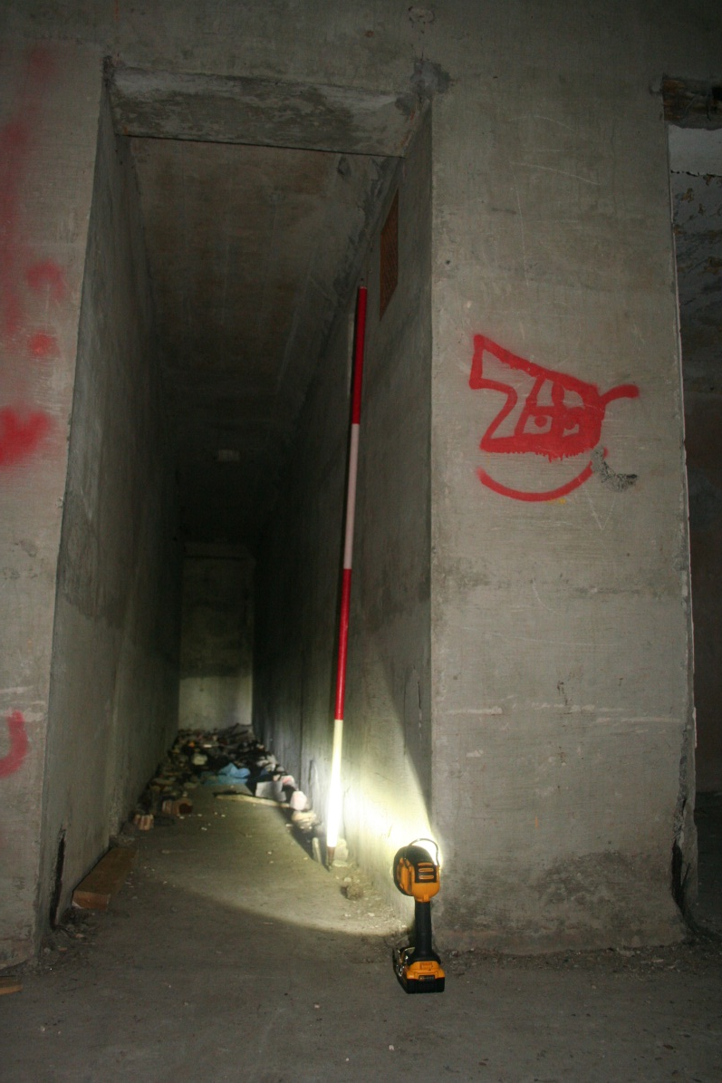
2. Why was the roof of the structure covered in sand and grass?
3. Why was there a raised platform leading to the individual rooms?
4. What is the purpose of the narrow tunnel leading behind the rooms?

Slide 15
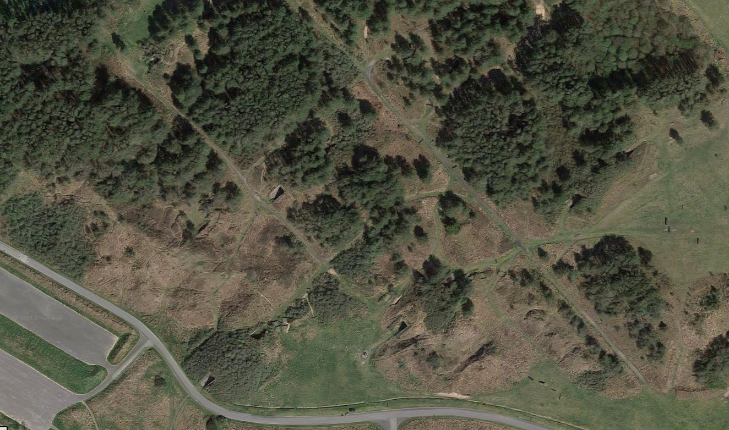
Can you spot the structures in this aerial photo?

Slide 16
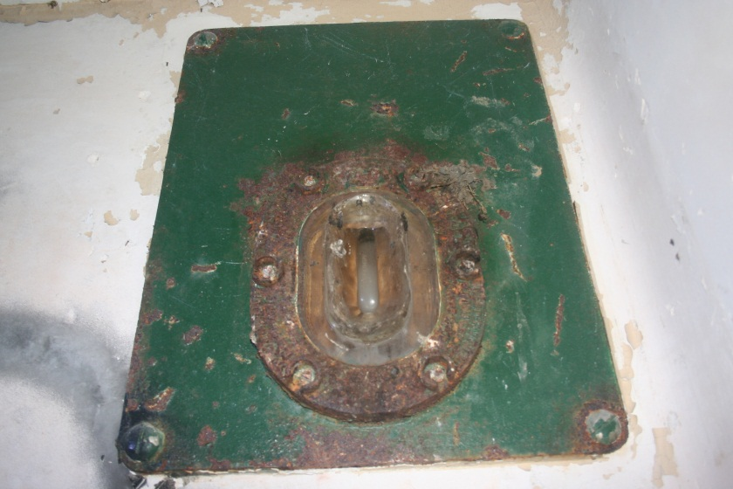
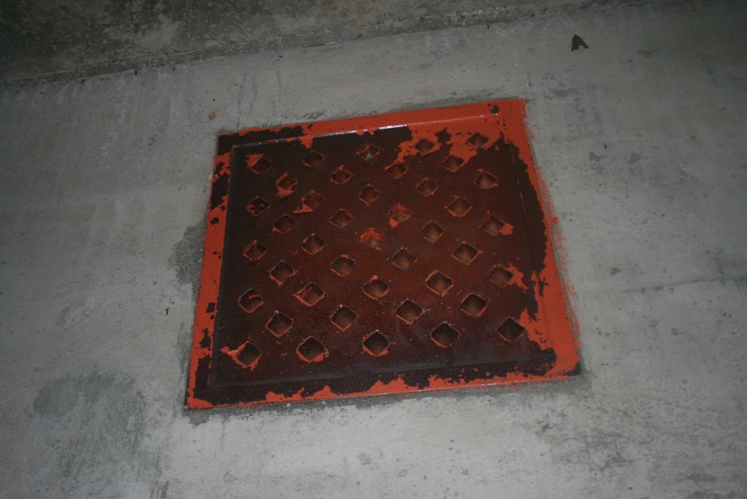
The structures are called magazines – they were constructed at the start of the second World War in 1939. They were made from concrete and brick and were used to store highly explosive material.
The raised platform is not only used to load onto trains that came into the magazines for loading and unloading but also to make sure that the rooms were kept well ventilated.
A tunnel ran around the back of the rooms to ensure that cables used for lighting did not get near the explosives – any spark could cause an explosion. Ventilation grates also kept the room ventilated.
The magazines were covered in sand and grass to minimise the impact should an explosion occur. The fact that they were covered with sand made them difficult for German bombing planes to see them overhead.

